Slide 1

Information Assurance
Introduction To Information Assurance

Slide 2
Information Value
Data is not just valuable to attackers and owners. It is valuable to cybersecurity efforts as well.
Information is only valuable as intelligence…
“There are known knowns. There are things we know that we know. There are known unknowns. That is to say, there are things that we now know we don’t know. But there are also unknown unknowns. There are things we do not know we don’t know.” – Donald Rumsfeld
Aka. Cyber Situational Awareness

Slide 3
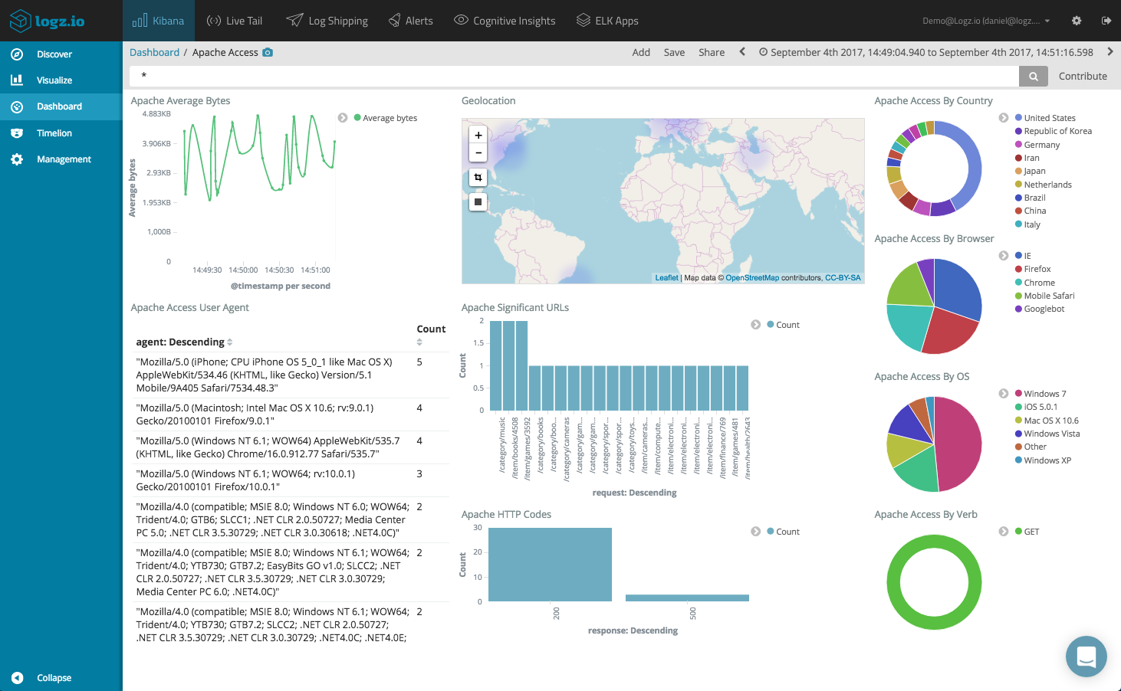
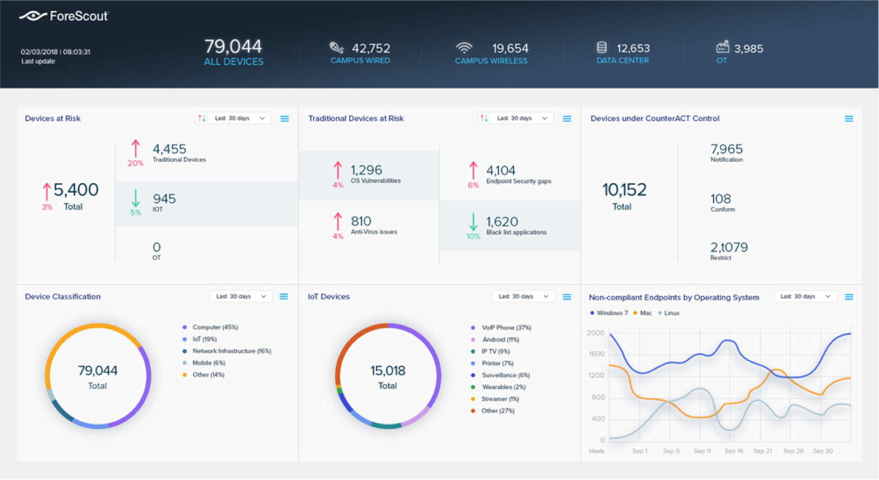
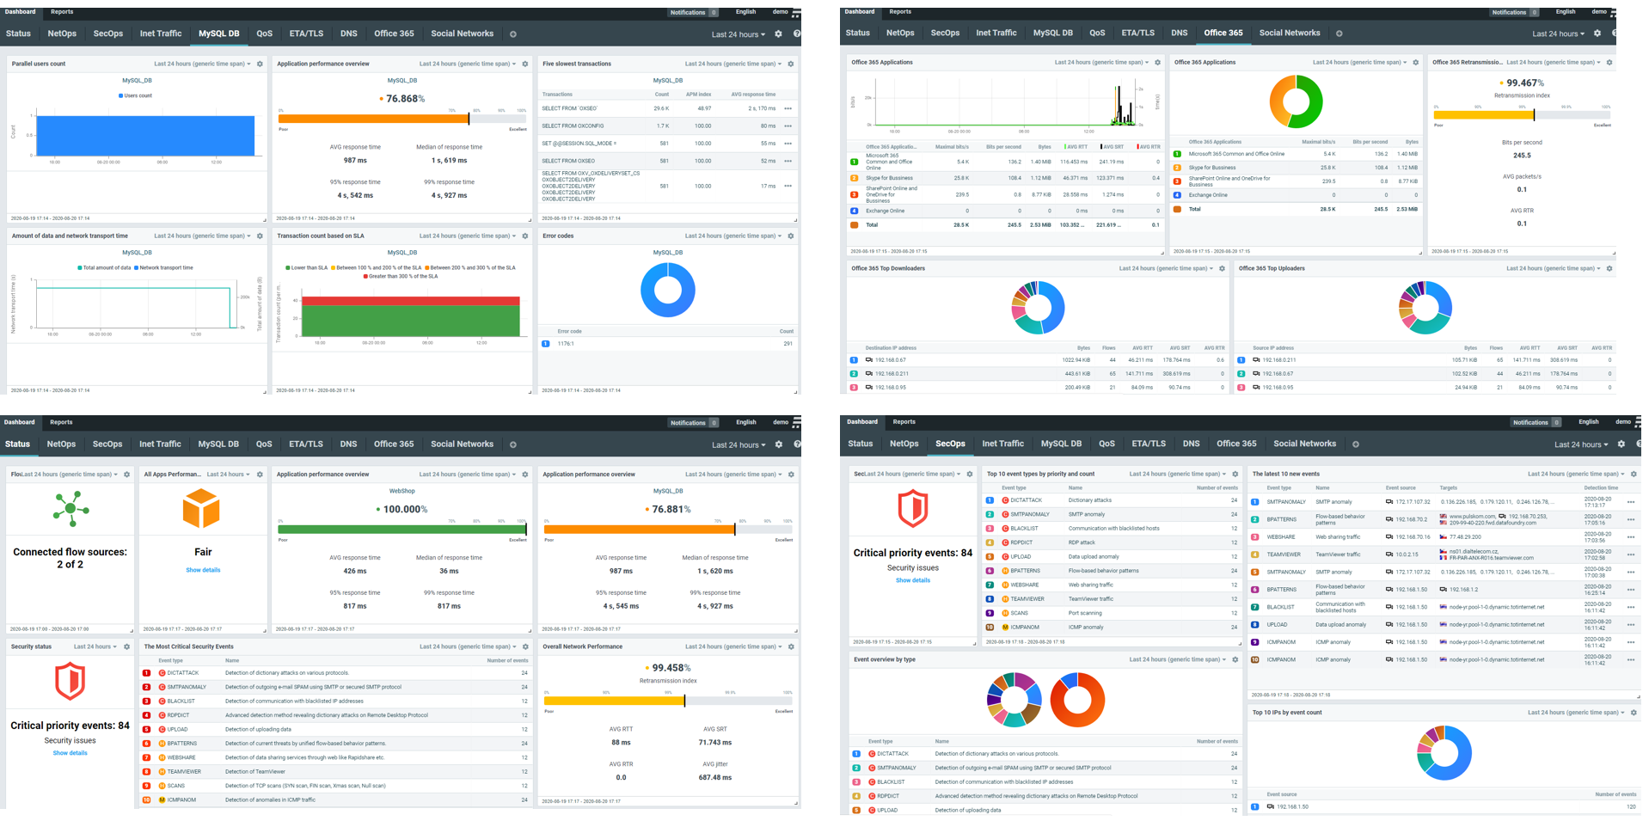

Slide 4
Intelligence is not a dump stat
Many industries, particularly cybersecurity, lives and dies by intel.
Intel is the interpretation of data into information and application to a topic.
Example – Datum is a single list of responses to a survey. Data is collecting and compiling those results. Information is a reflection of responses (this is what is happening.)
Intelligence/understanding an interpretation of those results indicating that ransomware is on the rise.
Knowledge is developing practical response and prevention measures (gathering data and intelligence in that process) in response to this threat.
Wisdom is learning lessons from outbreaks and improving practices as a result.

Slide 5
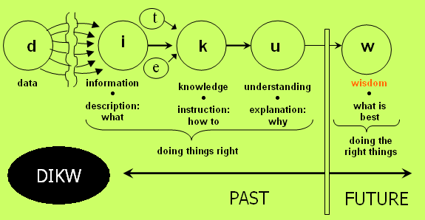

Slide 6
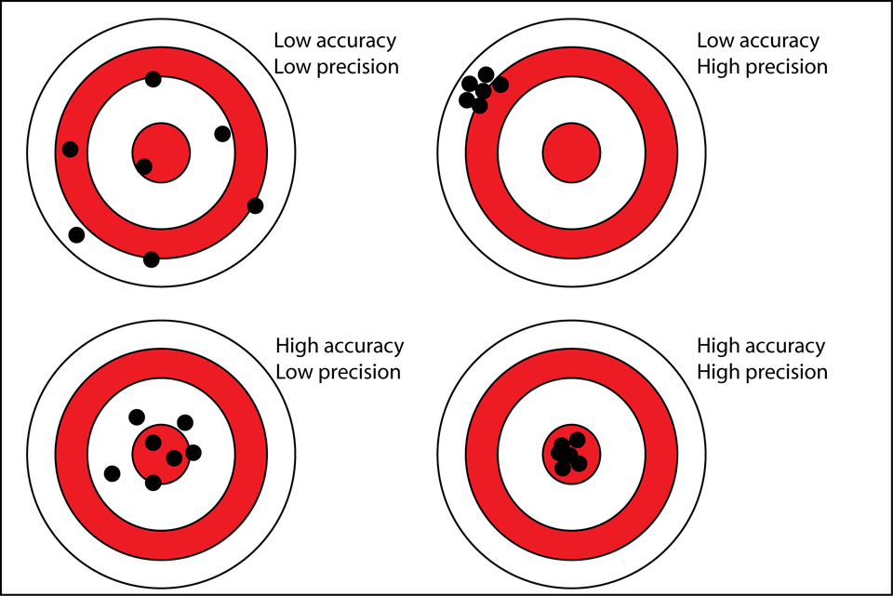
Data is always accurate, measurement is not

Slide 7
Cybersecurity metrics
The most valuable information in information assurance (related to your organization) are:
KPIs (Key Performance Indicators)
KRI (Key Risk Indicators)
Security metrics provide you with intel, but also with the information you need to report up, down, and out in your organization. Before we talk about what the most important/valuable data for that is, we need to talk about making sure any data you get is good data.

Slide 8
Data abuse
Discrimination
Predictive analytics, or breach of confidentiality used to defame or demean individuals.
Identity Theft
Exposure of personal information leading to financial losses or loss of public trust.
Loss of Anonymity
Exposure of data leads to re-identification or provided the basis for disambiguation.
Sovereign Exemptions
Government agencies collecting data with impunity, without governing law or public knowledge.
Data Brokerage
Big data markets engaged in selling data that is outdated, inaccurate, and/or unprotected.
Misinterpretation
Utilizing data with faulty methodologies or where the integrity has not been preserved. Collecting MORE data instead of high-quality data.

Slide 9

Misinformation
There’s a lot of reasons people would provide false information:
Financial / Ideological – Support interests, discredit competitors.
Amusement – Entertaining self/others.
Ignorance – Easy answers are easy.

Slide 10
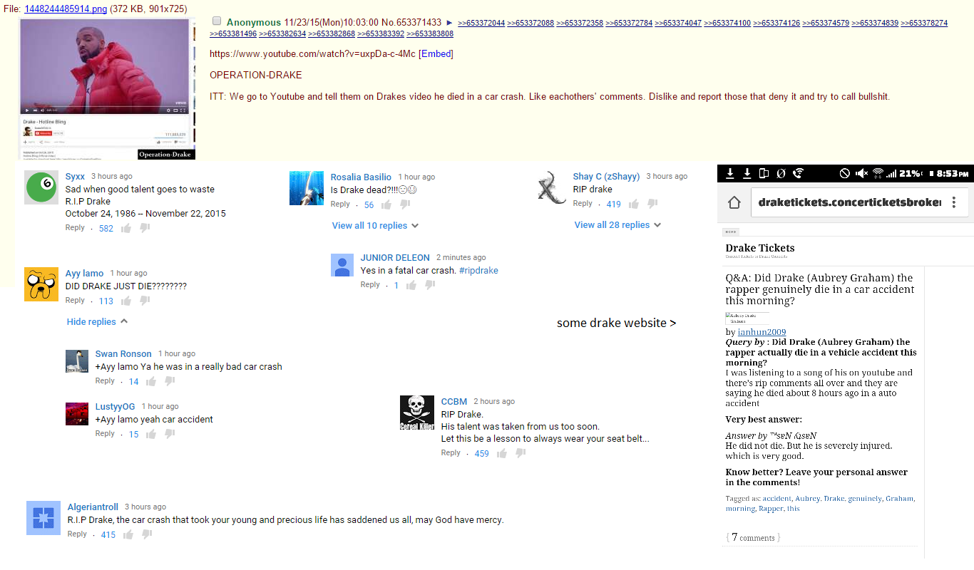
Misinformation

Slide 11
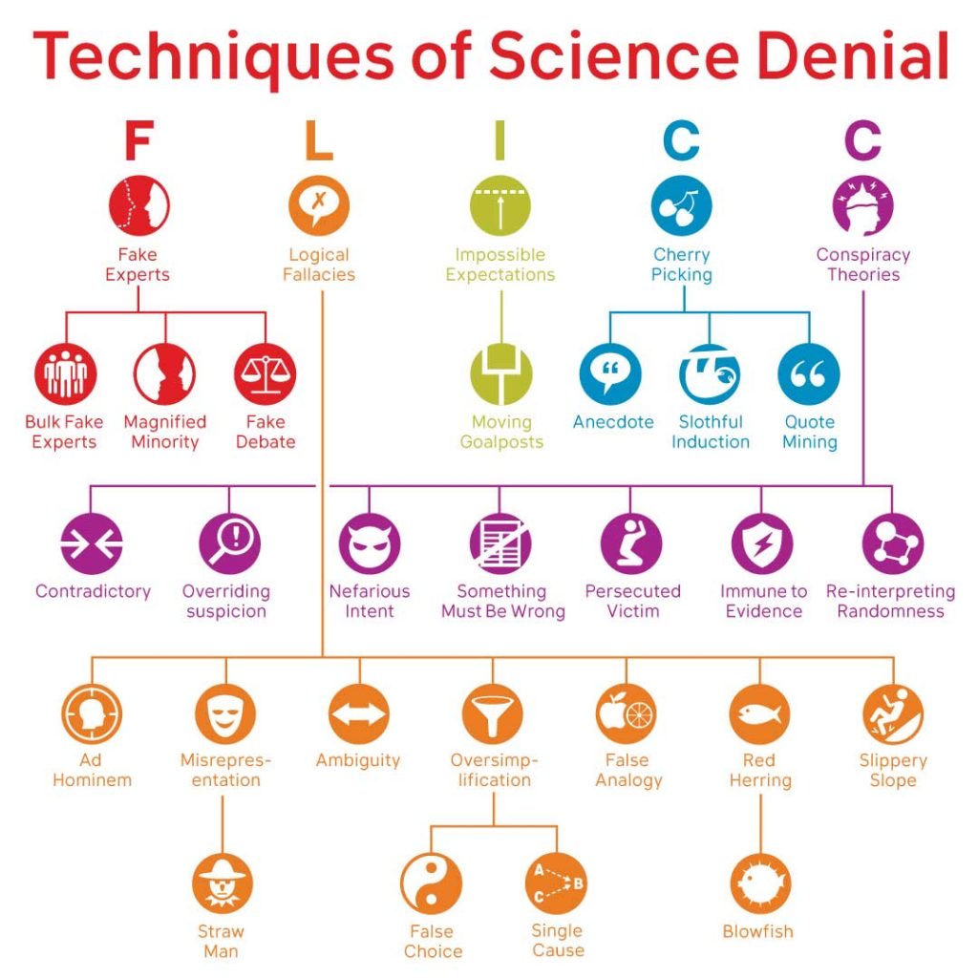
Misinformation
There’s a lot of reasons information in your organization might be misleading as well:
Incomplete information
Intentional sabotage
Misinformation/Misapplication

Slide 12
Making Data Useful
Productivity on an assembly line is measured before Christmas break and then after. Fewer units are assembled after than before. Data -> Interpretation.
Employees who get breaks work slower?
Employees work faster when they have a break coming up to look forward to?
It takes a while to ramp back up to capacity after a break?
Inefficiencies in operations create delays after a break?

Slide 13

Misinterpretation

Slide 14
Quantification of Situational Awareness
Objective Measures: Comparing an individual’s perceptions of the situation or environment to some “ground truth” reality
Subjective Measures: Asking individuals to rate their own or the observed SA of individuals on an anchored scale
Performance Measures: Better performance usually indicates better SA, performance measures infer SA from performance outcomes.
Behavioral Measures: Based on the assumption that good actions usually follow from good SA and vice-versa, behavioral measures infer SA from individuals’ actions.

Slide 15
Reporting out
Security events:
IPs by alert from source = How widespread an attack is.
Number of alerts per IP from source = How acute an attack is.
Critical OS events to detect Time Machine attacks and information needed for incident response.
AV and other last-line alerts.

Slide 16
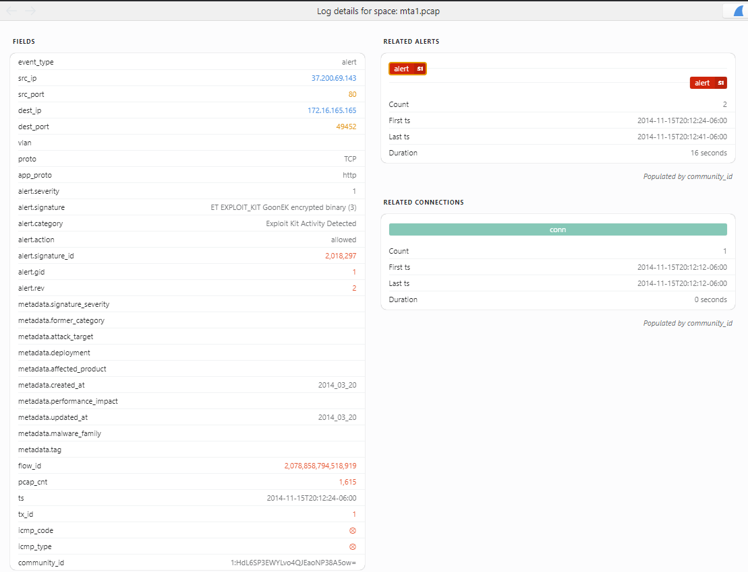

Slide 17
Information Sharing and analysis
Information sharing via official channels has improved greatly since 2008, but information still requires processing to be useful to organizations.
https://www.nationalisacs.org/

Slide 18
Reporting Up
Level of Preparedness - ‍How many devices on your corporate network are fully patched and up to date? Vulnerability scans and vulnerability management is one of the 20 CIS Controls that can reduce the risk of vulnerability exploits.‍
Unidentified Devices on Internal Networks - ‍Employees can introduce malware and other cyber risks when they bring in their own devices, as can poorly configured Internet of Things (IoT) devices.
Intrusion Attempts - ‍A security incident isn't just a successful cyber attack, intrusion attempts to vendors can signify your organization as a potential target

Slide 19
Reporting Up
Security Incidents - ‍How many times has an attacker breached your information assets or networks?
Mean Time to Detect (MTTD) - ‍How long do security threats go unnoticed? MTTD measures how long it takes your team to become aware of indicators of compromise and other security threats.
Mean Time to Resolve (MTTR) - ‍What is the mean response time for your team to respond to a cyber attack once they are aware of it? A great measure of the quality of your incident response plan implementation.

Slide 20
Reporting Up
Mean Time to Contain (MTTC) - ‍How long does it take to close identified attack vectors across all endpoints?
Patching Cadence - ‍How long does it take your team to implement application security patches or mitigate high-risk CVE-listed vulnerabilities? Vendor patching cadence is also important.
Access Management - ‍How many users have administrative privileges? Access control and the principle of least privilege are simple, cost effective methods of reducing privilege escalation attacks.

Slide 21
Reporting Down
Essentially – cybersecurity training. Whatever form that takes. More important is to keep it simple and relevant. Limit topics to need-to-know.
Cyber hygiene
Spotting common user attacks
How to report suspected incidents

Slide 22
Valuation -> Risk
White Market Approach – The approach used in insurance. Market value at time of issue. Market value of asset at time of loss. How much is the data worth in open markets?
Black Market Approach – How much is the data worth in criminal markets? For data sold on white markets, it will be less, but black markets also deal in data not available on open markets.
Multi-period excess earnings method (MPEEM) – Amount of revenue an asset generates – the amount an asset costs = value of the asset.
With-and-Without – The value of data is based on the performance of the organization with it and without it.
Cost Approach – The amount it would take to restore the data if lost.

Slide 23
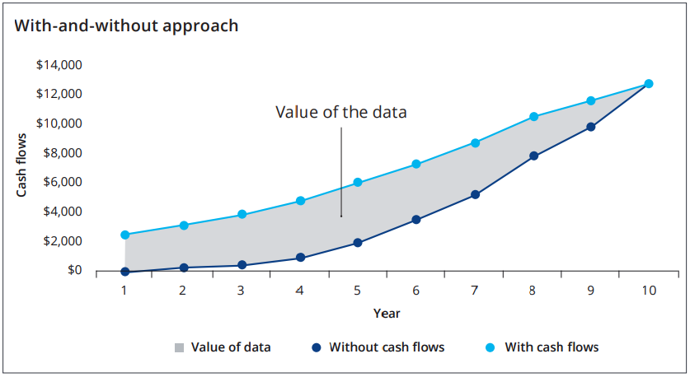

Slide 24
